Slide 1


MENTOSHIP PROGRAM
Our Students, are paired with mentors who are drawn from across the globe, who guide them ontheir duties

Slide 2
E.I.M Learning and Development Consult is a management consultancy whose main focus is to provide corporate institutions and organizations with well qualified and professional Interns. Our Interns, are paired with mentors who are drawn from across the globe, who guide them on their duties thereby ensuring organizational growth and development to any institution privileged to hire them. We also provide High end trainings to Employees of our partners to keep them update with growing industry trends.
- About us

Slide 3
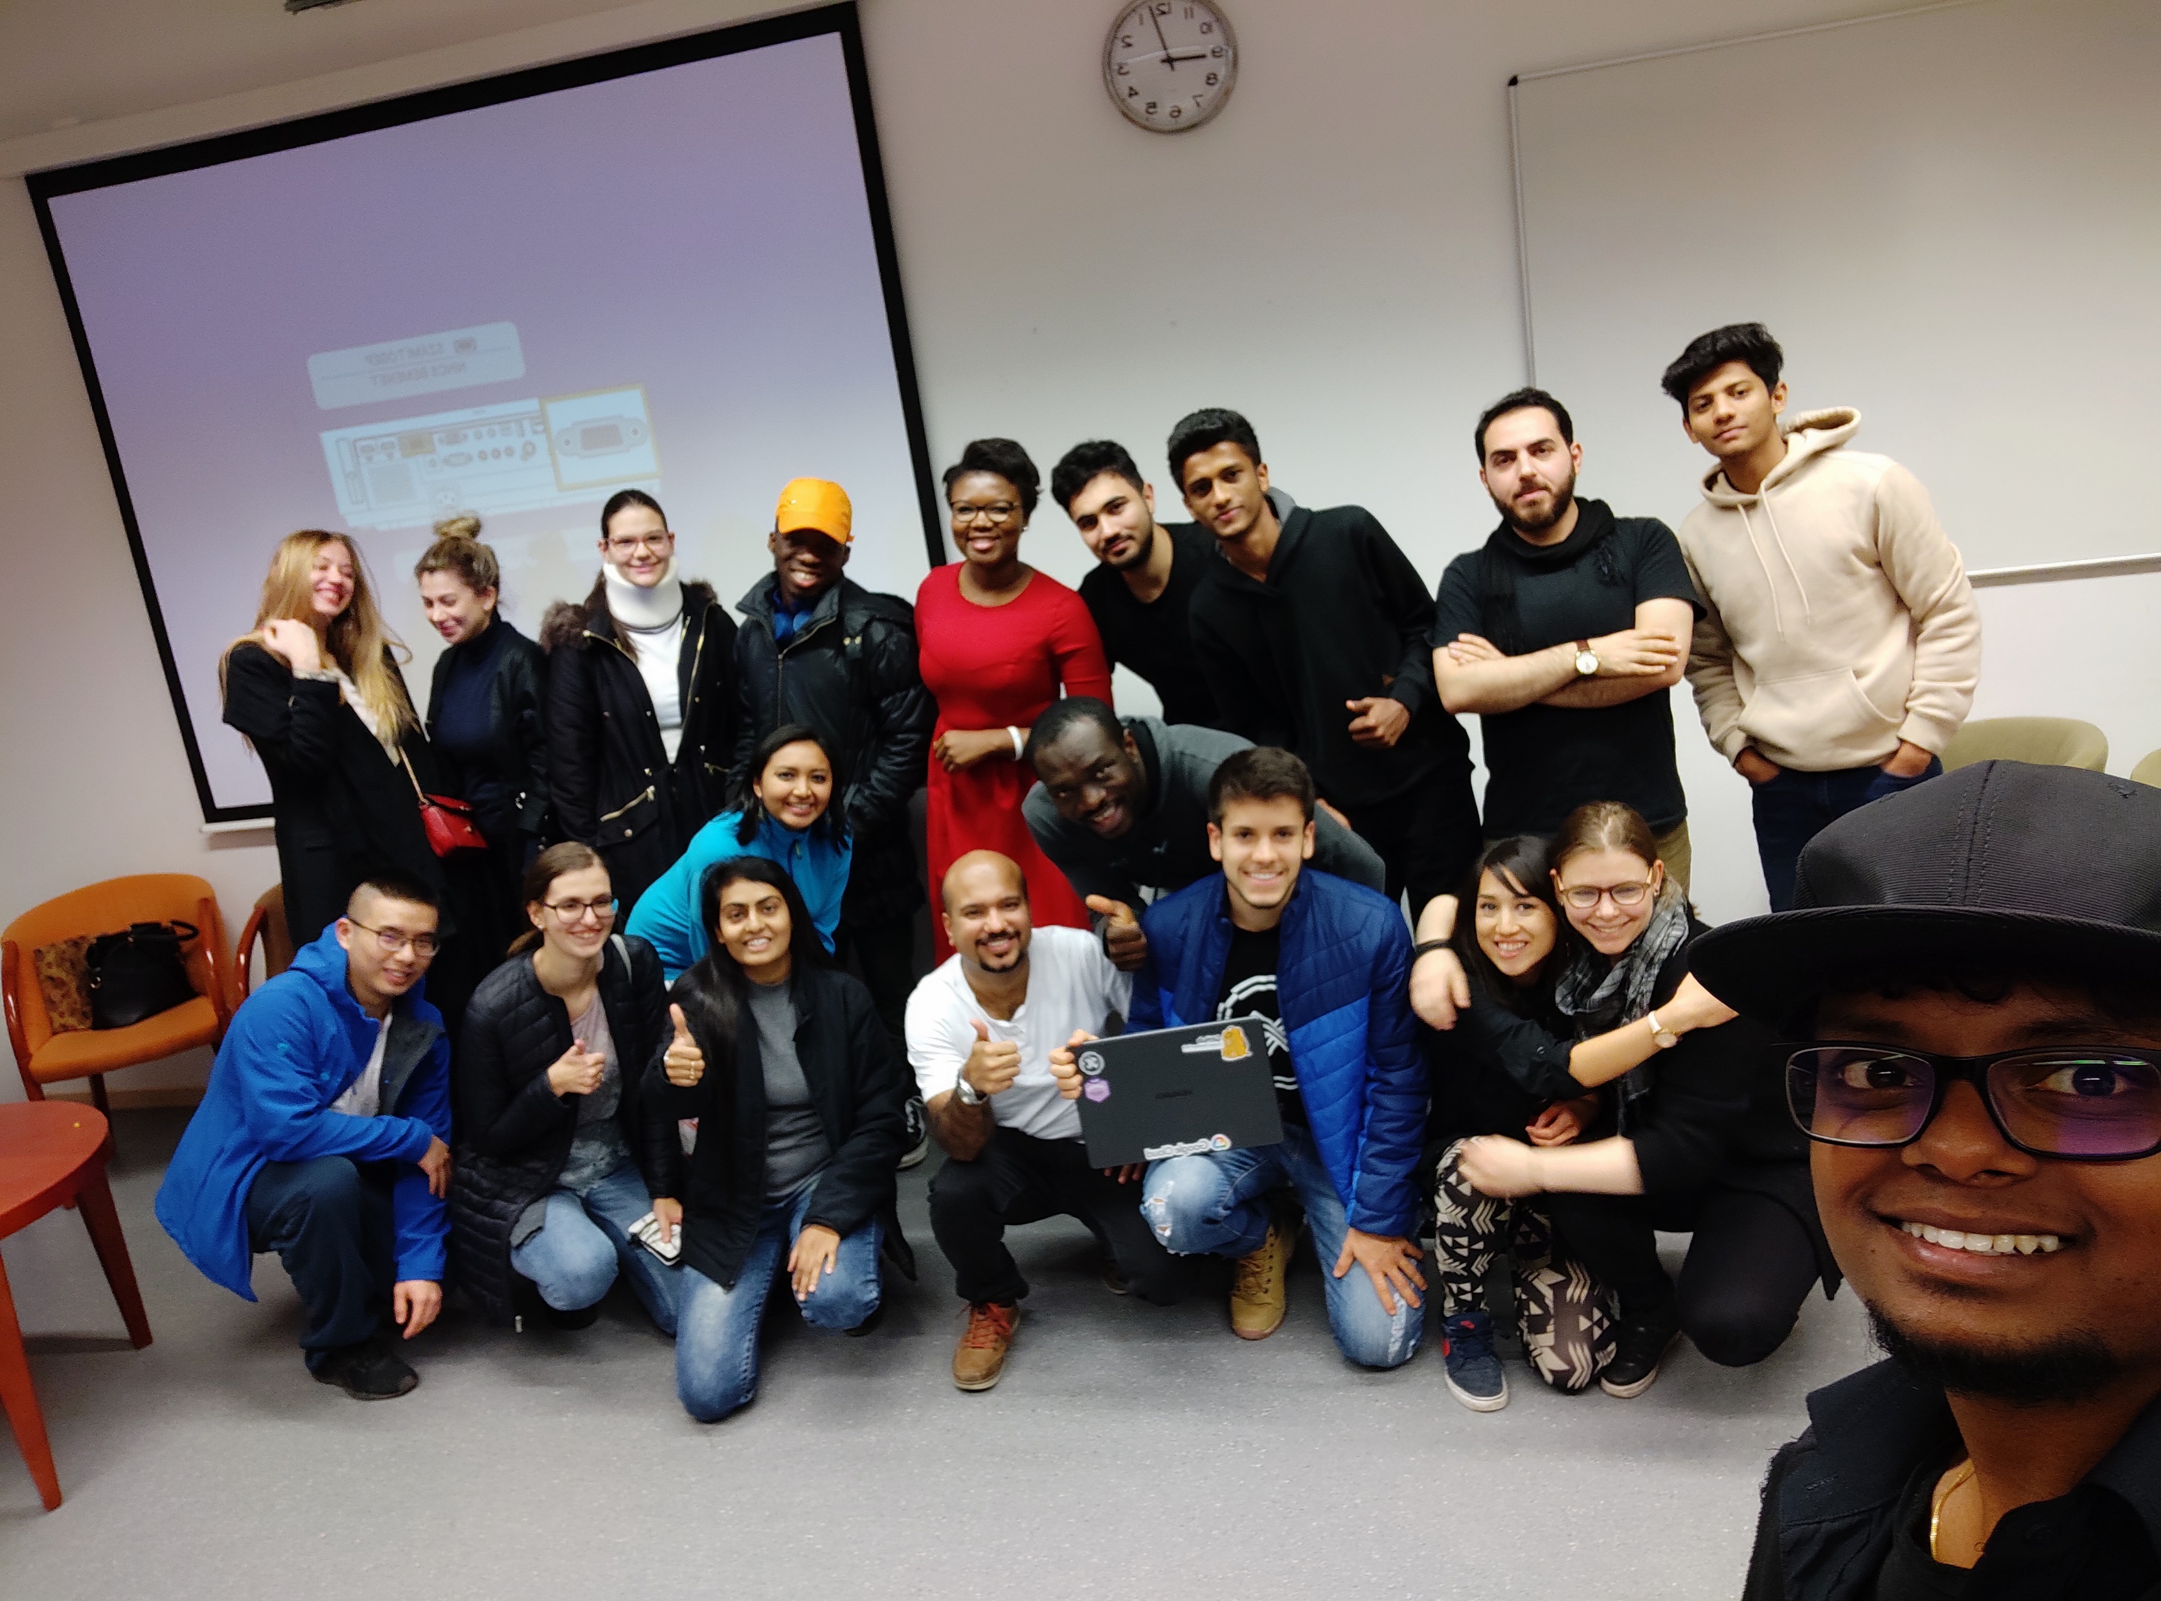
MENTORSHIP PROGRAM
Objectives:
Provide a platform for Professionals to share their experiences and career advice with our students, and for all to benefit from learning diverse cultures .

Slide 4
Expectations
Mentees
Desire to develop and enhance a variety of competencies; Motivated to succeed
Take initiative to drive relationship / be responsible for own development
Have well-defined objectives / let your mentor know what he/she can do to help you
Mentors
Encourage and foster the mentor-mentee relationship
Encourage mentee to mange their own learning, develop their skills, improve their performance, and maximize their career growth

Slide 5

Expectations Cont’d
Both
Be involved, available and accessible
Importance of confidentiality should be discussed at the first meeting
Provide feedback about relationship and be open to receive feedback
“If your actions inspire others to dream more, learn more, do more and become more, you are a leader.”
- John Quincy Adams

Slide 6
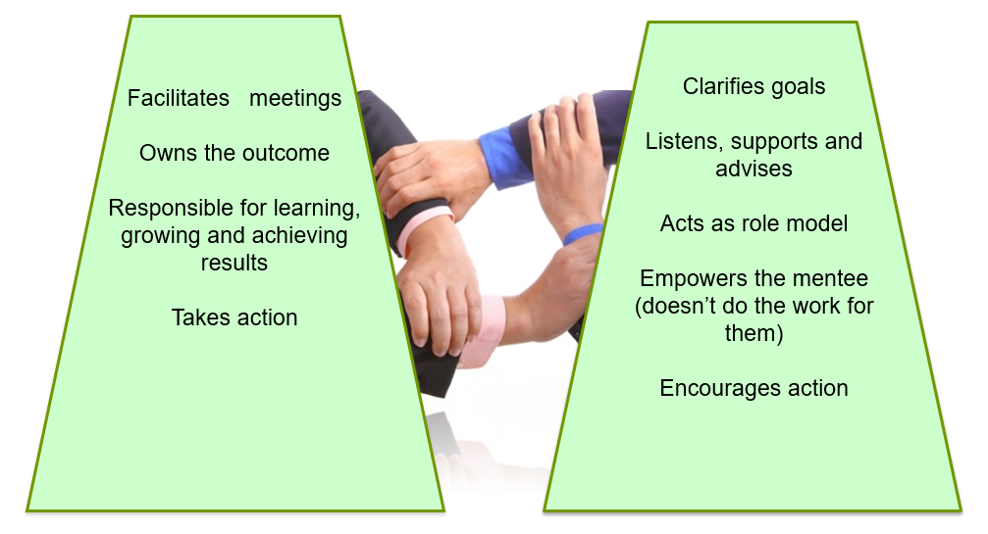
Responsibilities
Mentee
Mentor

Slide 7
WHAT’S IN IT FOR YOU?
As a mentee you will
-Have a “friend” whom you can bounce off any ideas relating to your career
-Seek guidance without any judgment
-Get a different perspectives
As a Mentor you will
-Gain satisfaction from helping others, knowing that you make a difference
-Develop your leadership skills
-Learning from your mentee

Slide 8
AGREEEMENT FORM
Name of Mentor: ____________________________________________________________________________________
Occupation & Company: ___________________________________________________________________________________________
Country of Residence: _______________________________________________________________________________________________
Relevant competencies: ____________________________________________________________________________________
______________________________________________________________________________________________
Preferred Student:______________________________________________________________________________________________________________________________________________________________________________________
AUTHORIZING OFFICER
Name:______________________________________________________________________________________________________________________________
Designation:___________________________________________________________________________________________

Slide 9
CONTACT
EMAIL
MOBILE
WEBSITE
SOCIAL MEDIA
eimconsultld@gmail.com
+233273330992
www.eimafrica.com
@eimldconsult

